Slide 1
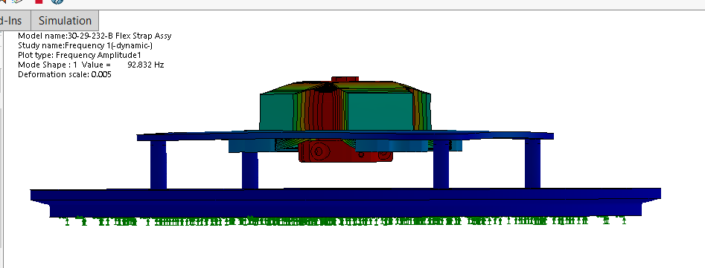
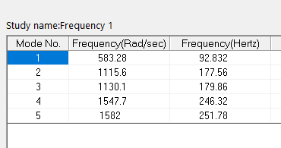
Thermal Flex Strap Analysis

Slide 2
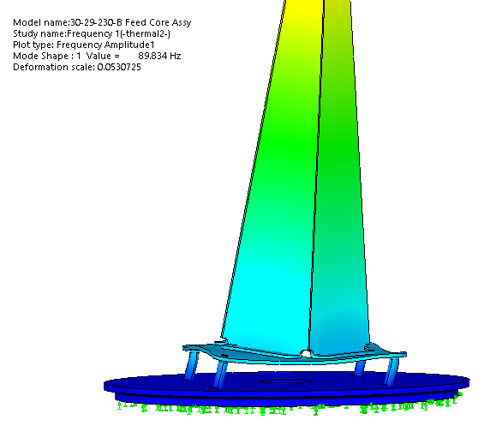
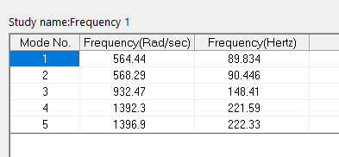
Pyramid/Base/Standoff Frequency Analysis

Slide 3
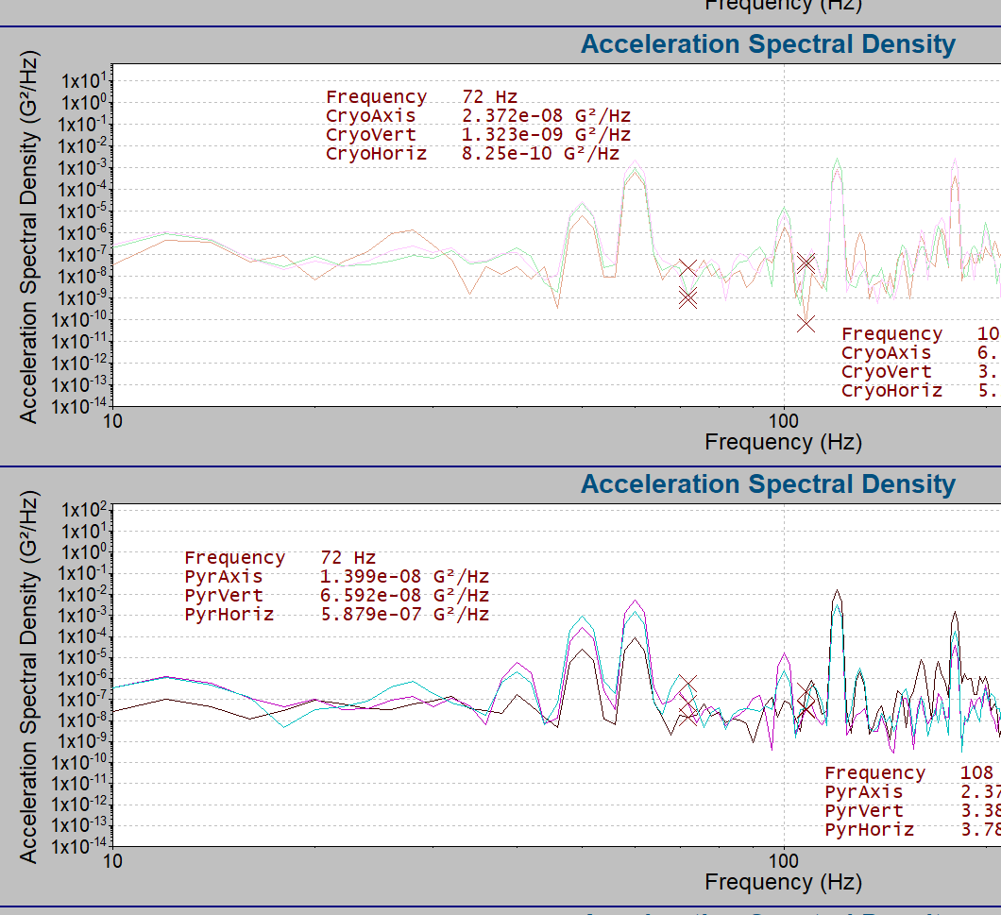
Cryo cooler three-axis input vibration:
and
Pyramid three-axis response:
Plots look similar… implies rigid body motion

Slide 4
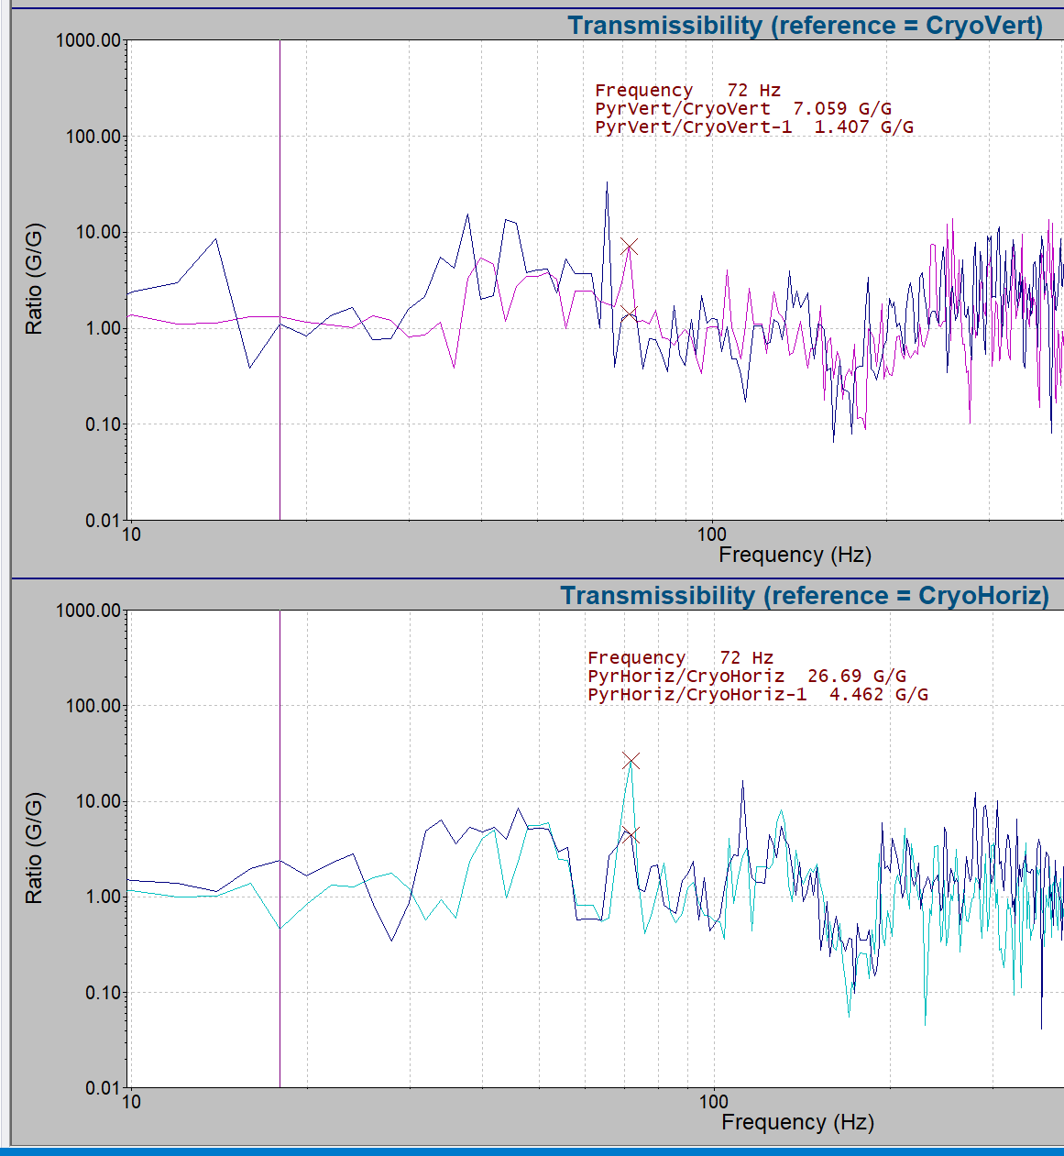
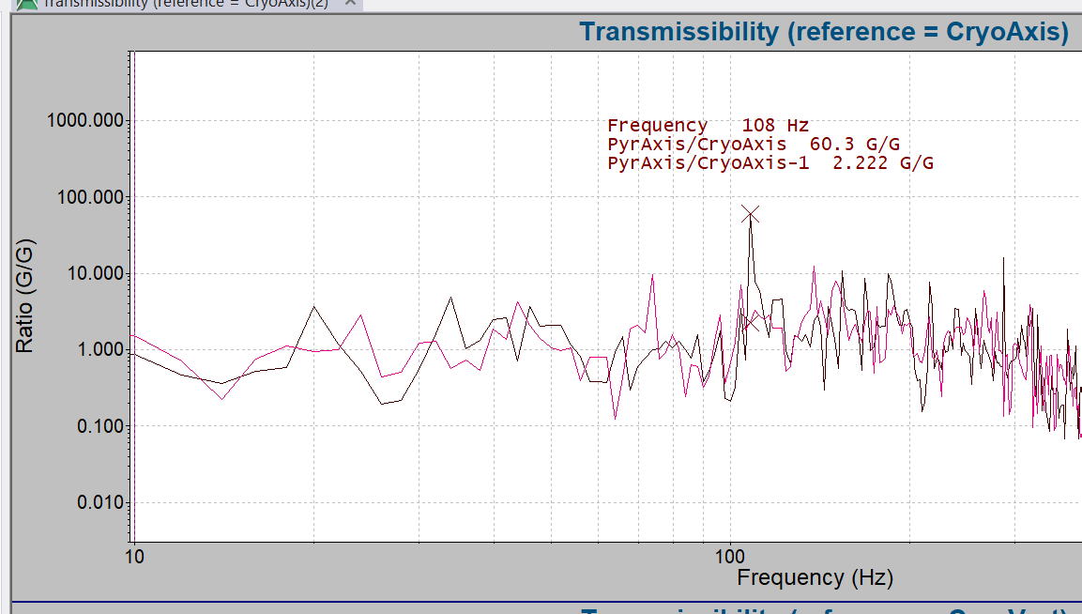
No thermal flex plate
No thermal flex plate
No thermal flex plate

Slide 5
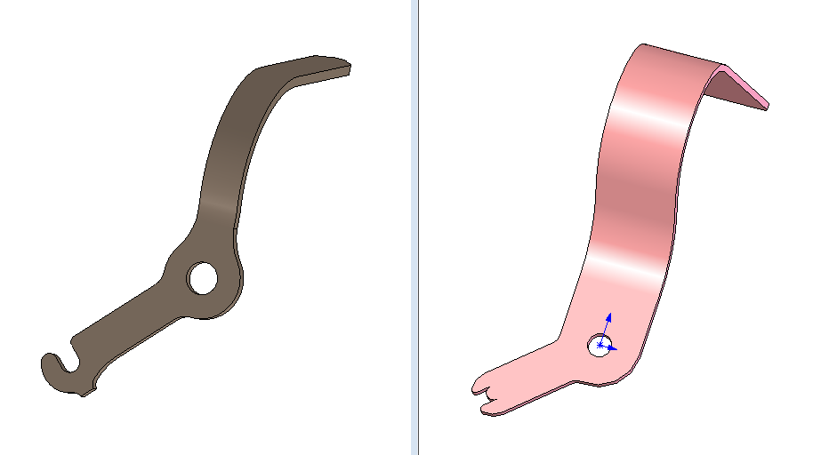
Combine link designs
Get quote for parts
Design forming tool

